Slide 1

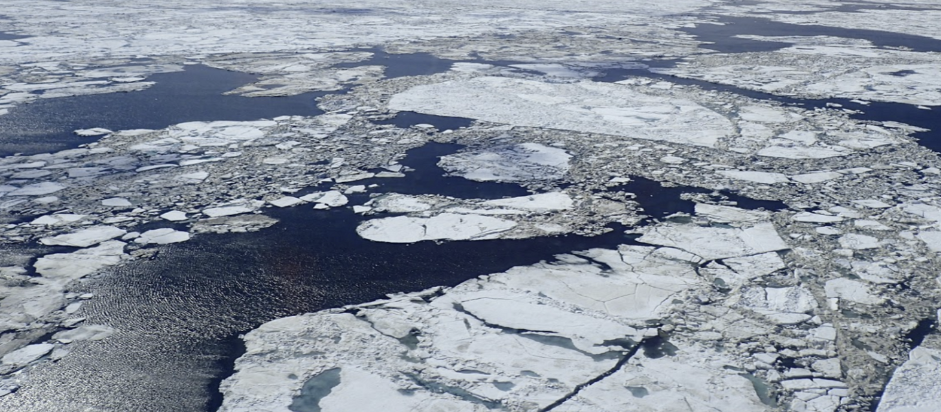
Alaska Sea Ice Program
Ice Edge Forecast Verification
Kayla Tinker
Kayla.Tinker@noaa.gov

Slide 2
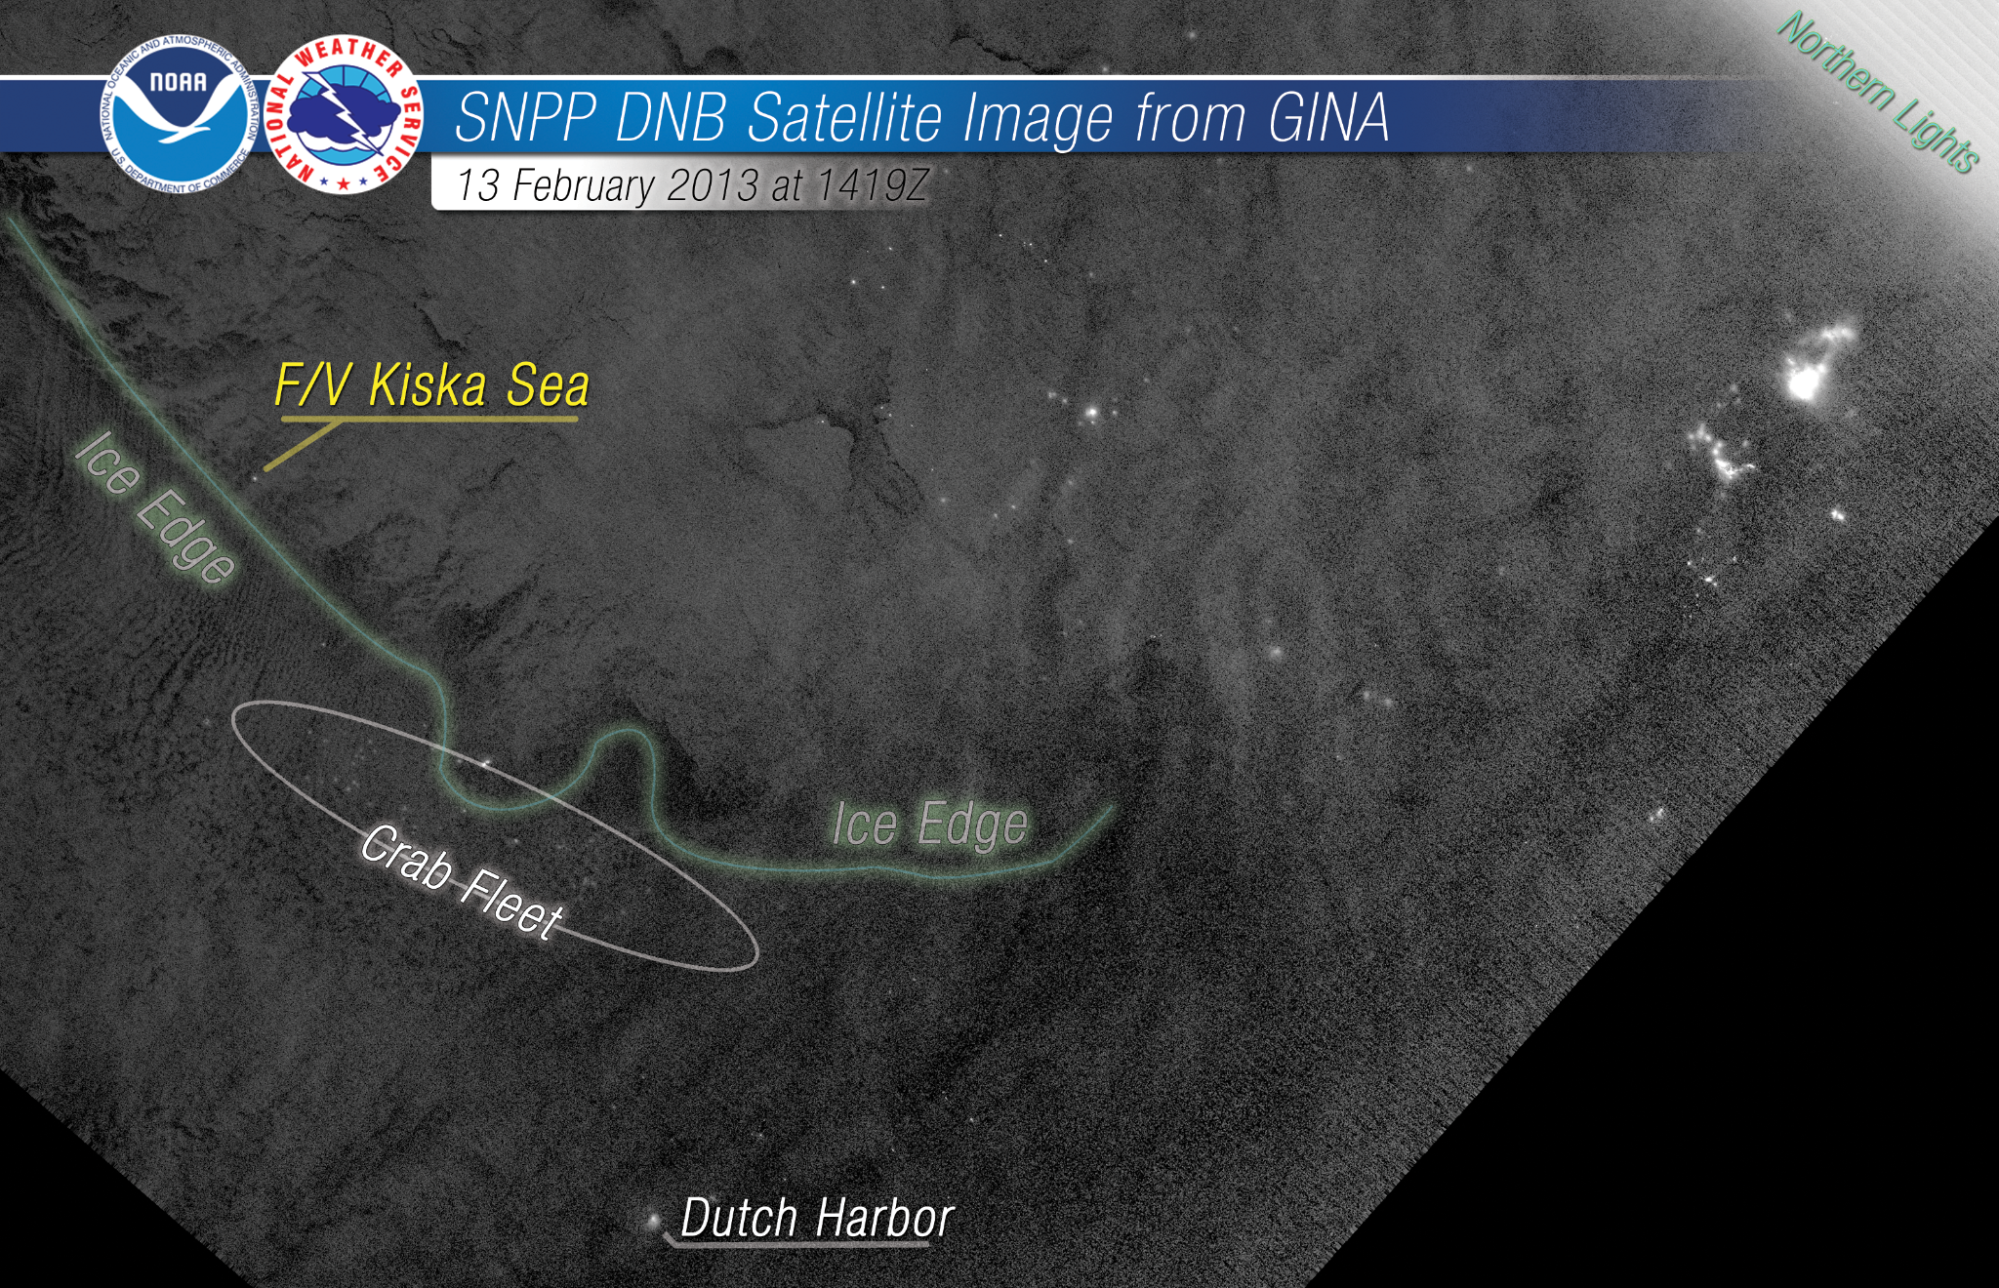
Overview
Why the sea ice edge?
Accurate sea ice edge forecasts are essential for the operations and planning in the Arctic
Notes:
The National Weather Service (NWS) Alaska Sea Ice Program (ASIP) mission is to protect life and property.
Accurate sea ice forecasts, particularly sea ice-edge forecasts, are essential for the operation and planning of human activities in the Arctic.
This photo shows an example of that importance where the crab fleet is located right along the ice edge.
You can see the ice edge is denoted by the green line and the crab fleet is a bunch of bright speckles that is highlighted in the circle

Slide 3
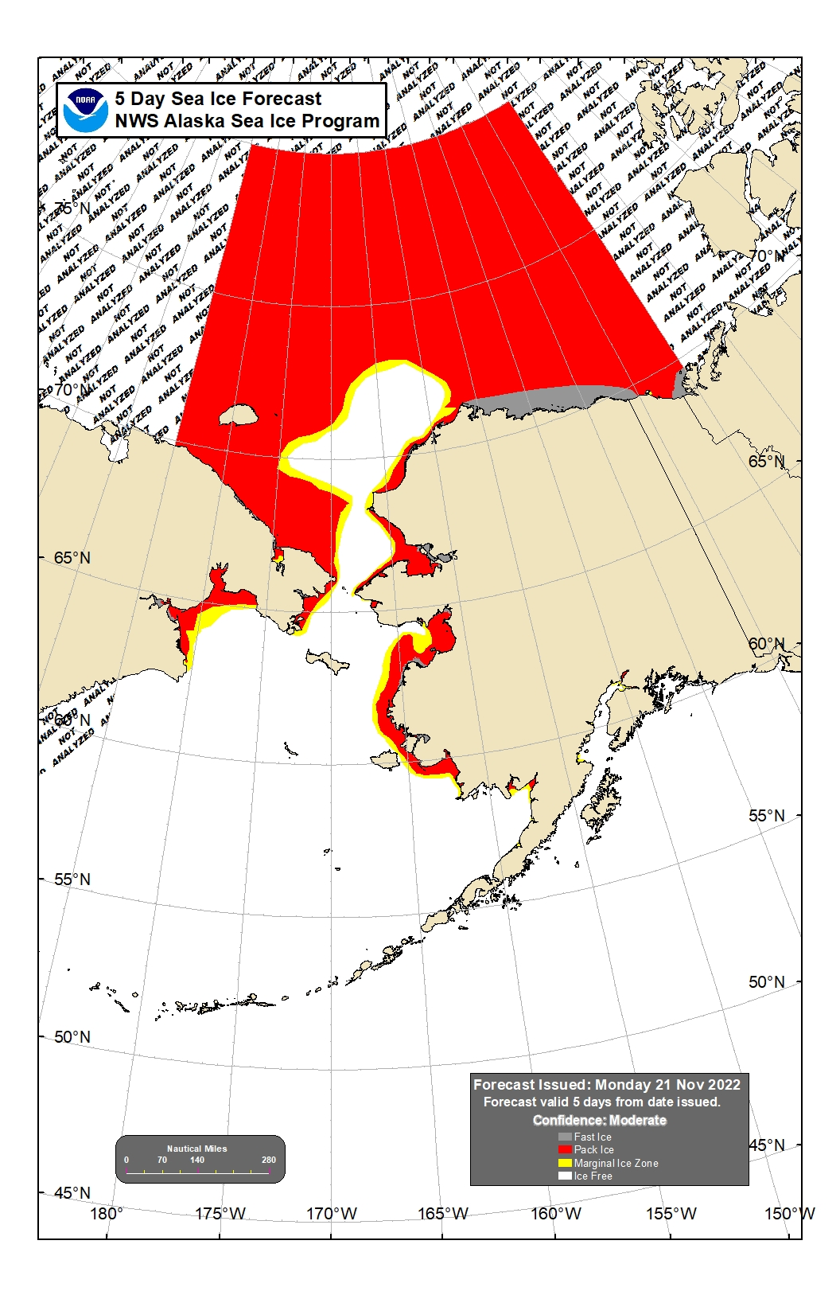
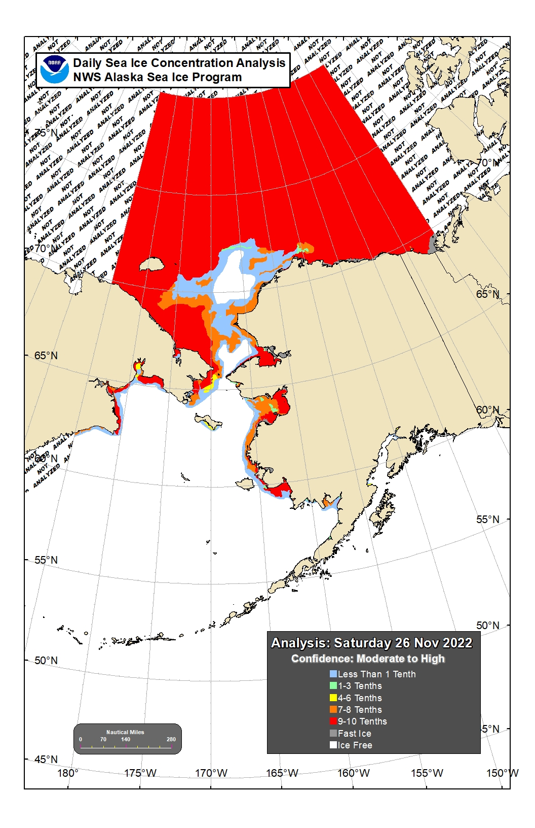
5-day out Forecast
Analysis
Chukchi Sea
Beaufort Sea
Cook Inlet
Bering Sea
Notes:
The team issues daily sea ice analyses and a five-day out sea ice concentration forecast for the three seas that border Alaska: Bering Sea, Chukchi Sea, and Beaufort Sea as well as Cook Inlet
In this study, we evaluate the team’s sea ice-edge 5-day forecast using the ice analysis as our ground truth. The sea ice edge is denoted here with a blue line. If we take a quick look at this image, we can see that we under forecasted in some areas and over forecasted in others.

Slide 4
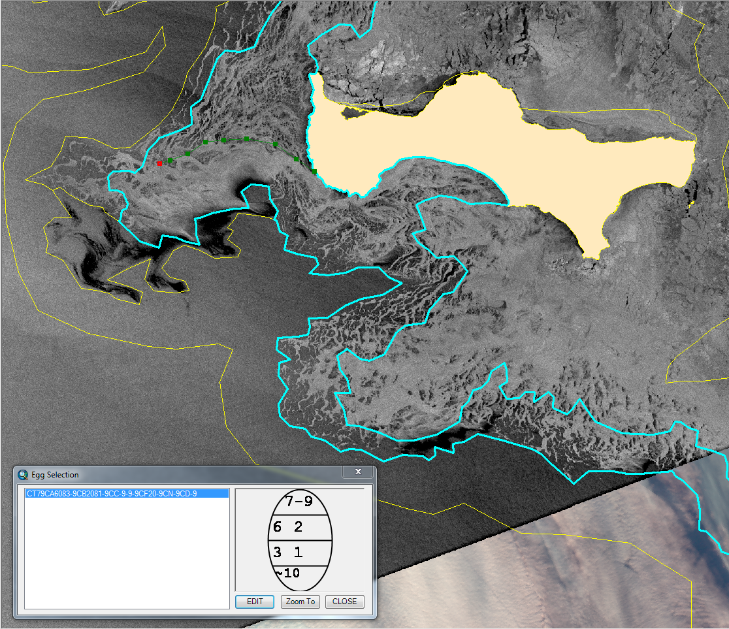
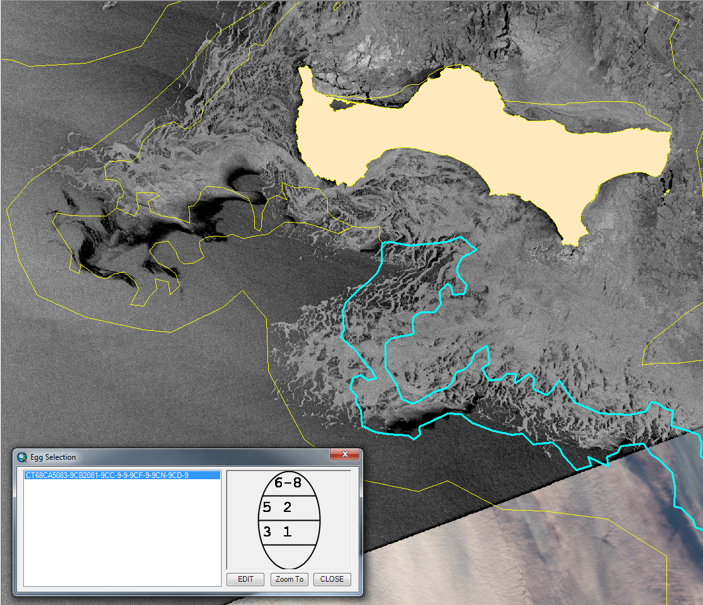
INTRODUCTION QUESTIONS METHODS RESULTS FUTURE
Subjective interpretation of satellite images to create polygons
Notes:
Let’s first talk about our process.
Subjective interpretation of satellite images is performed by the team to polygonize the sea ice areas of the same attributes, working off the previous days version.
In this image, we have our yellow analysis lines that group together different ice characteristics with an overlap of a map and sea ice imagery.
The cyan line is the same as the yellow line, but is the selected polygon at the moment.
In this first image, we have not updated the analysis yet.
What changes could we make? Let’s take a look at the highlighted red circle area. [click] Now here is what the updated yellow lines may look like.
Note that each shape is subjective, but the focus of our study is the ice edge.

Slide 5
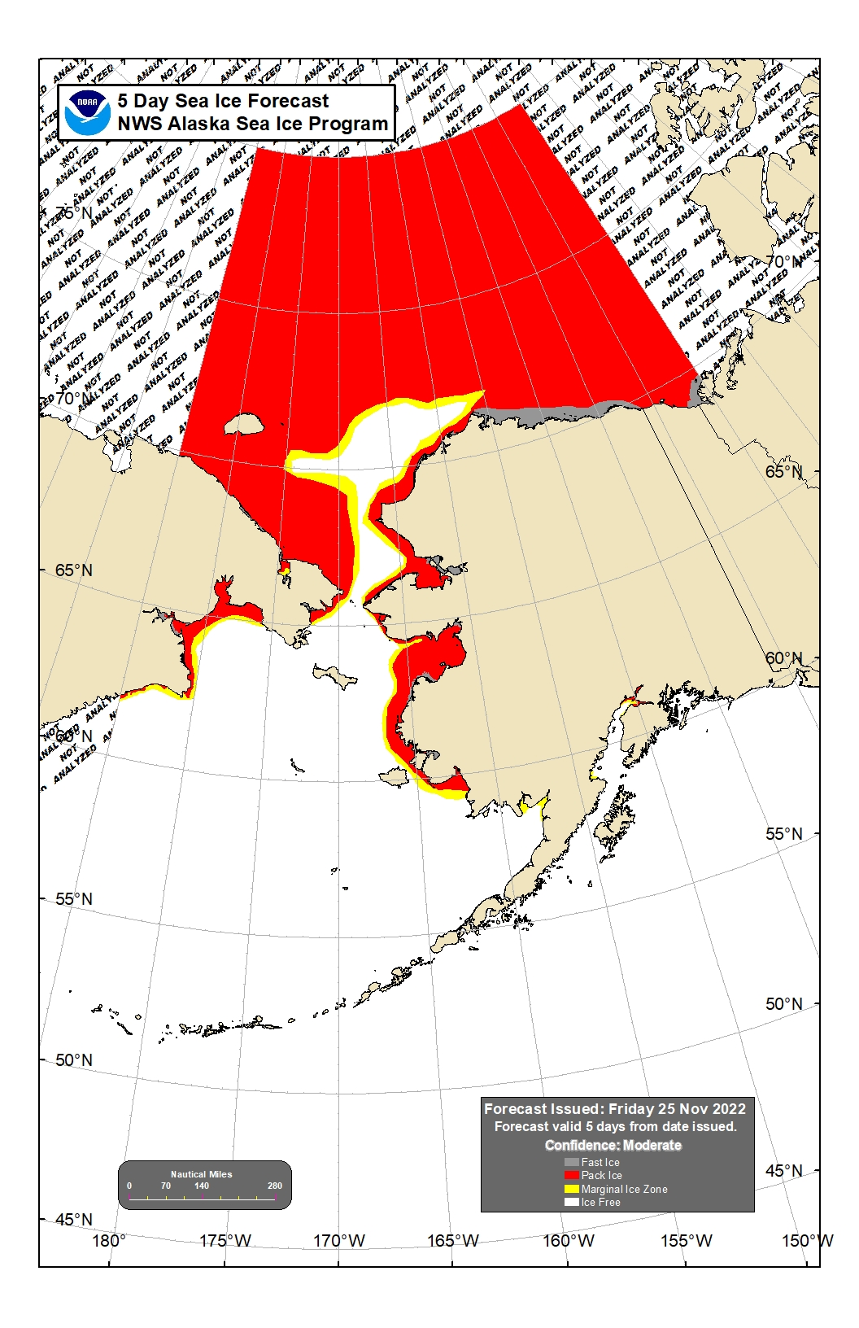
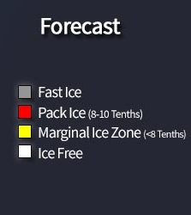
INTRODUCTION QUESTIONS METHODS RESULTS FUTURE
Notes:
In our case, we define the ice edge as this contour here [click], that denotes the separation from ice free to the 0 to 1 tenth concentration of ice.
Previous studies have used a contour to denote the ice edge at the 15 percent line, but because our 5 day out forecast only denotes ice free vs. marginal ice (the yellow), that is the option we have chosen for this study. The process of completing the 5 day out forecast, usually starts with a model as the first guess of the pack ice, and is then the analysis for that current day is adjusted by the analyst. We also denote our confidence level when issuing products, with a forecast confidence of either High, Moderate, or Low.

Slide 6
Q: How can we verify our ice edge forecasts?
Q: What impacts the forecast accuracy?
Q: Is there a bias in the forecast?
Q: Can we better utilize our “confidence” label?
INTRODUCTION QUESTIONS METHODS RESULTS FUTURE
Notes:
Our main question we will answer today is how can we verify our ice edge forecast? Additional questions include, what impacts the forecast accuracy and can we better utilize our “confidence” label of high/moderate/or low? Note: Known limitations include relying on human interpretation of satellite data and estimating the true sea-ice conditions based on observations, or lack thereof.

Slide 7
Methods

Slide 8
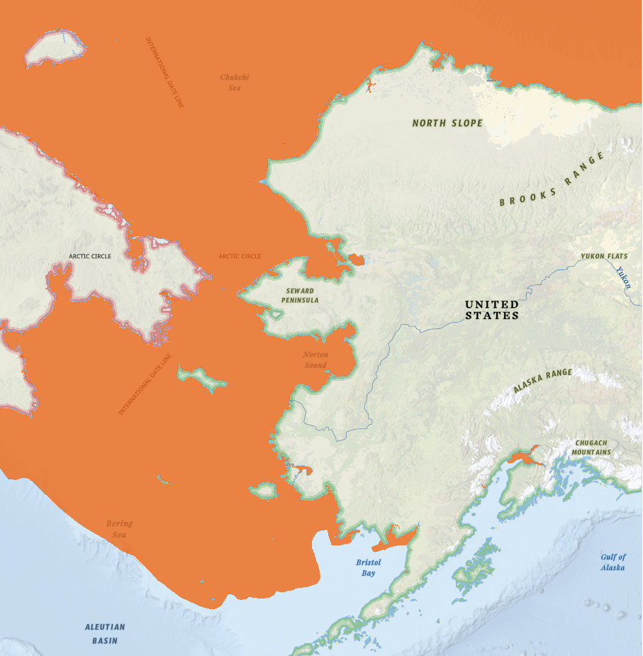
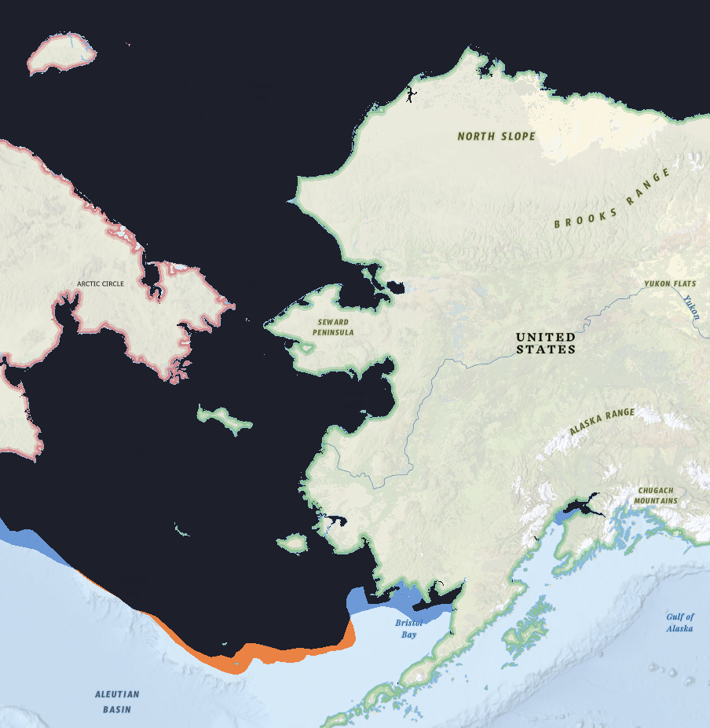
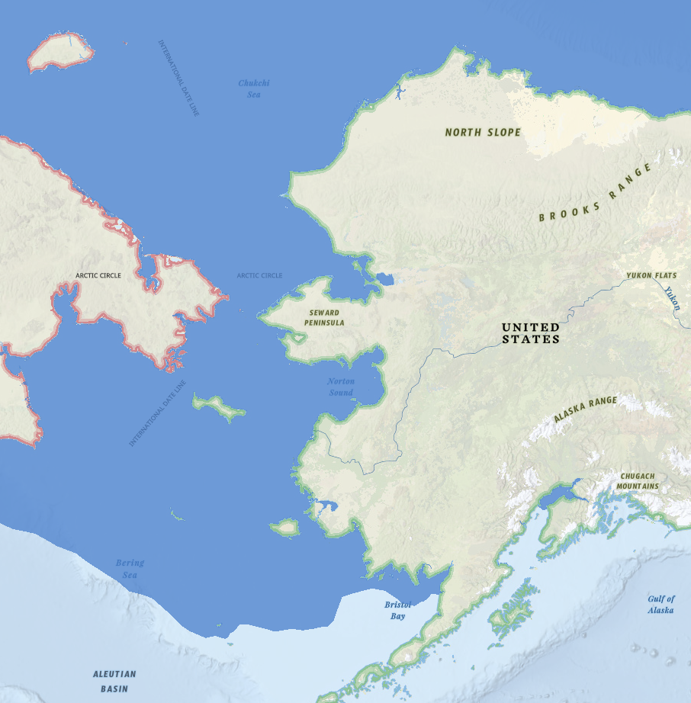
INTRODUCTION QUESTIONS METHODS RESULTS FUTURE
Analysis for April 6th
Forecast for April 6th
Overlap
Forecast
Analysis
Notes:
So what were our steps in verifying our 5 day forecast? The most straightforward means to evaluate sea ice edge forecast is simply to compare forecasts at a specific lead time to the manual produced subjective analysis valid at the same time. First, we have our forecast, with this example created on April 1st and valid for April 6th. The blue area represents everywhere where the forecasters thinks there could be any ice, so more than 0% concentration. Next, we have in orange, our analysis on April 6th, which we will use as ground truth. Note the limitations again here, where some areas may not of been changed from the day before due to data sparsity. Once we have our analysis that we are using as ‘ground’truth, we figure out what areas overlap, what areas we over forecasted for, and what areas we under forecasted for. And this is our result. Note that the orange is under forecasted areas and blue is over forecasted areas. So what do those numeric values looks like?

Slide 9
INTRODUCTION QUESTIONS METHODS RESULTS FUTURE
Ice Edge Error Metrics
Integrated Ice Edge Error (IIEE) [Goessling et. al. 2016]
IIEE = Over + Under
*conceptually simple
Notes:
This forecast verification is definite by Goessling et al 2016 as the integrated ice-edge error (IIEE). This error is the summation of area that was over forecasted plus the area that was under forecasted and is represented in area square kilometers.
This is conceptually simple and easy to calculate. These methods were done on each forecast over the 2022 year.

Slide 10
INTRODUCTION QUESTIONS METHODS RESULTS FUTURE
High confidence
Moderate confidence
Low confidence
Notes:
In addition to the IIEE, I also wanted to look at the forecasters confidence, which is subjective, to see if we can or should adjust how we utilize this option. This was done by viewing each forecast image, to denote the confidence level found on the image and marked next to the IIEE value after computation.

Slide 11
Results

Slide 12
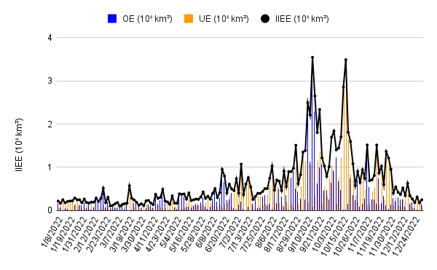
INTRODUCTION QUESTIONS METHODS RESULTS FUTURE
Overlap
Forecast
Analysis
Date Forecast is Valid for
Notes:
By finding the integrated ice-edge error, over forecast, and under forecast errors for each forecast (3 per week times 52 weeks), gave us the resulting graph. [click] You can clearly see the spikes in the falltime, when the ice edge length is larger and thus more room for error.

Slide 13
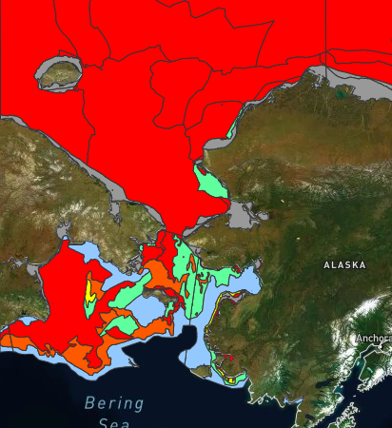
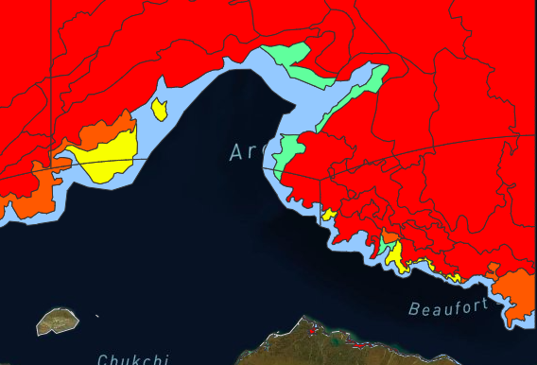
INTRODUCTION QUESTIONS METHODS RESULTS FUTURE
May
October
Notes:
May 4 vs. Oct 4 As you can see, the difference from May to October, is that the ice edge is significantly longer, leading to more room for error.

Slide 14
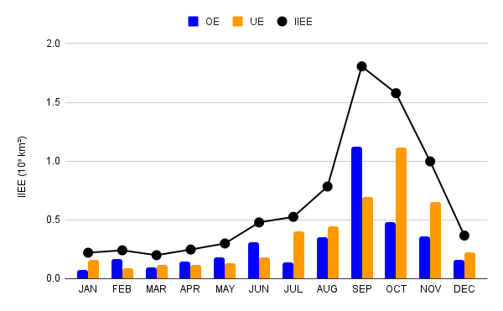
INTRODUCTION QUESTIONS METHODS RESULTS FUTURE
Notes:
But what really stood out, was the difference between the months. September we over forecasted and October we under forecasted.

Slide 15
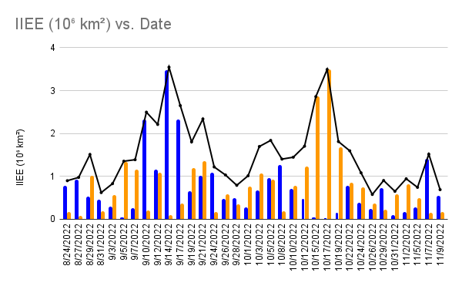
INTRODUCTION QUESTIONS METHODS RESULTS FUTURE
Sep 17 2022
Oct 17 2022
Sep 28 2022
Notes:
So let’s take a look at different events, Sept 17 … Oct 17…Sept 26 & 28. I will also add, that these days have different forecasters (3 team members plus a fill-in), so the error was not in correlation with one specific person. Nor were these errors based on the day of the week (Monday vs. Friday)

Slide 16
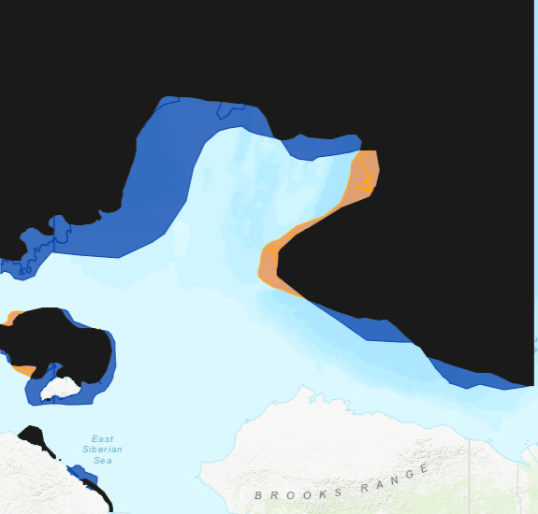
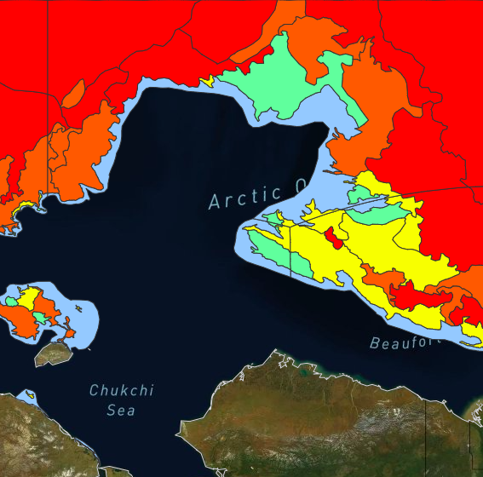
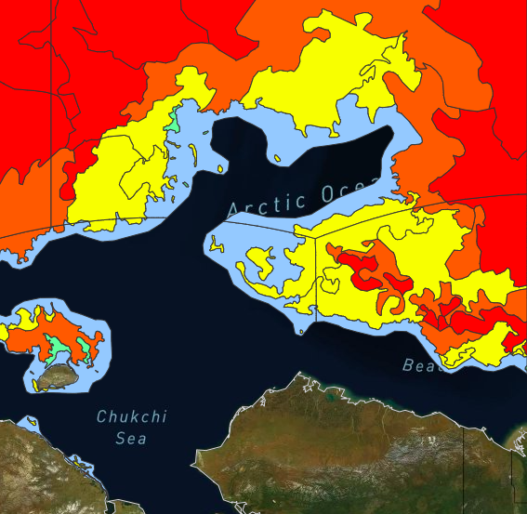
INTRODUCTION QUESTIONS METHODS RESULTS FUTURE
Sept Over-forecast Bias | Forecast valid on Sept 17
Sept 12 Analysis
Overlap
Analysis
UE:0.34 10⁶km²
Forecast OE: 2.3 10⁶km²
Forecast Confidence: Moderate
Analysis Confidence: Moderate
Notes:
We have the overlap, over forecasted area in blue and under forecasted area in orange, which is the analysis for that day. Simply, you can see these is significantly more blue on the map, than orange and thus we over forecasted and there was more ice melt than anticipated. Forecast confidence on 9/12: Moderate Analysis Confidence on 9/17: Moderate

Slide 17
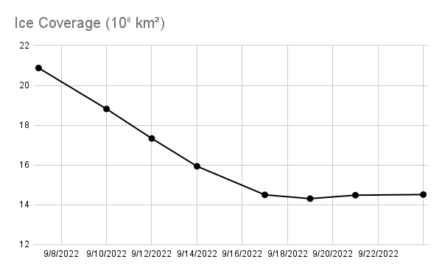
INTRODUCTION QUESTIONS METHODS RESULTS FUTURE
Sept Over-forecast Bias | Forecast valid on Sept 17
Overlap
Sep 12 2022
Analysis
Forecast
Sep 17 2022
Notes:
So what were the trends leading up to the forecast day of Sept 12, and what happened on the day of Sept 17? Data we did not have access to at the time, but would be helpful, is how the total ice was decreasing that entire week. To compare the change in overall sea ice, to the total forecast amount. What makes this case even trickier, is that it was decreasing every forecast period, But then hits the minimum and levels out.
When the forecast was made on 9/12, persistence could be used to help with the total area covered. BUT that doesn’t mean the forecaster would know for sure which area should be decreased in the forecast
At the time of the 5-day outlook there was a high pressure, so persistence may have been leaned towards. There was consistent ice melt leading up to this point, just not at the same rate. This error is higher than anticipated due to Extyphoon Merbok, a very strong low pressure that impacted erosion along the Alaska coast and brought strong winds across the Chukchi and Beaufort Seas, melting more ice than expected. The take away, is that there was a significant pattern change. There was evidence of the pattern change 5 days prior.
Pattern change - High pressure prior, changed to a strong low pressure with an increase in wind speeds from the south… Merbok

Slide 18
INTRODUCTION QUESTIONS METHODS RESULTS FUTURE
Oct 17 2022
Notes:
Sept 14 & 17 … Oct 15 & 17…Sept 26 & 28 Different forecasters, so it was not dependent on forecaster skill

Slide 19
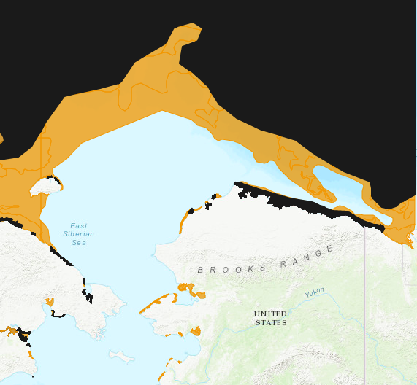
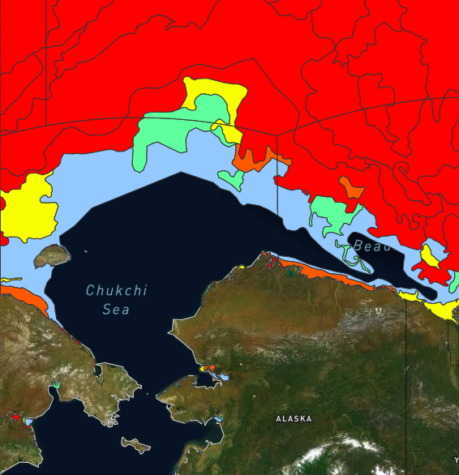
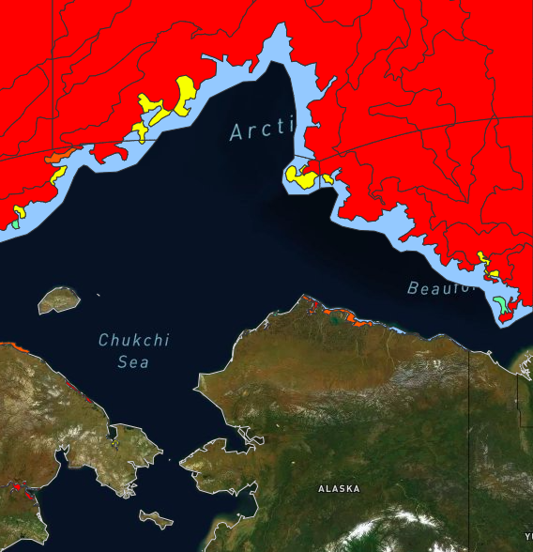
INTRODUCTION QUESTIONS METHODS RESULTS FUTURE
Oct Under-forecast Bias | Forecast valid on Oct 17
Oct 12 Analysis
Overlap
Analysis UE:3.48 10⁶km²
Forecast Confidence: Moderate
Analysis Confidence: Moderate to High
Notes:
In this example, we almost do not over forecast at all, but instead under forecast, where there is significantly more sea ice growth than expected. Again, this was due to a pattern change to northerly wind shift + colder air temperatures.
Forecast Oct 12 Confidence: Moderate Analysis Oct 17 Confidence: Moderate to High

Slide 20
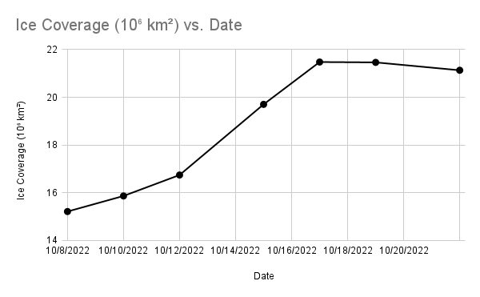
INTRODUCTION QUESTIONS METHODS RESULTS FUTURE
Oct Under-forecast Bias | Forecast valid on Oct 17
Oct 17 2022
Overlap
Oct 12 2022
Analysis
Notes:
The rate of change is much greater than it had been at the time of the forecast. The Oct 17 date, again was a transition point where the rate of change of sea ice was increasing significantly, and then leveled out after that date. Making it much harder to forecast.

Slide 21
INTRODUCTION QUESTIONS METHODS RESULTS FUTURE
Sep 28 2022
Notes:
Sept 14 & 17 … Oct 15 & 17…Sept 26 & 28 Different forecasters, so it was not dependent on forecaster skill

Slide 22
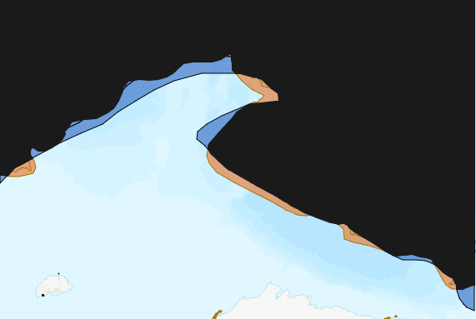
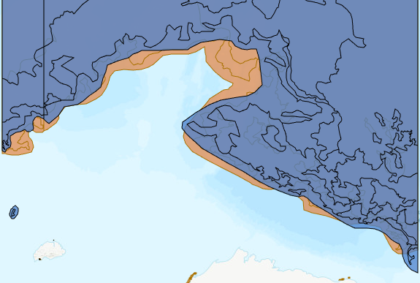
INTRODUCTION QUESTIONS METHODS RESULTS FUTURE
Sept Less Bias | Sept 23 Forecast valid on Sept 28
Overlap
Analysis 9/23
Forecast OE: 0.47 10⁶km²
Analysis 9/28
Analysis UE:0.33 10⁶km²
Analysis Confidence: High to Moderate
Forecast Confidence: High
Notes:
How close to analysis on 9/23 day?
Add CT to map The method in which we start our forecast shapes, is through the current forecast lines. This is great for those times when persistence would be used. You can see that based on our analysis from 9/23, that there were small changes to expand the ice edge. Was there a pattern of ice growth from 9/23 to 9/28 and thus persistence was used?
Forecast 9/23: High Analysis 9/28: High to Moderate

Slide 23
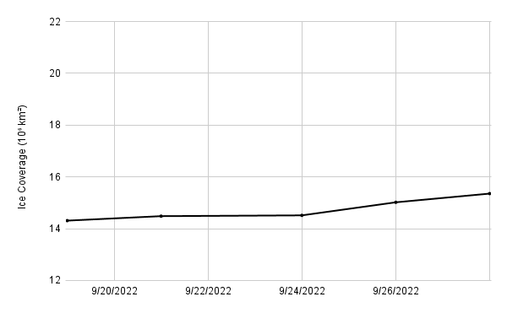
INTRODUCTION QUESTIONS METHODS RESULTS FUTURE
Sept Less Bias | Sept 23 Forecast valid on Sept 28
Overlap
Forecast OE: 0.47 10⁶km²
Analysis UE:0.33 10⁶km²
Notes:
So using the same ice coverage scale as the other charts, we can see the change of the overall ice area is much smalled, and there is consistent growth during the time frame, so persistence and starting with the 9/23 analysis. works well

Slide 24
Q: What impacts the forecast ice edge accuracy?
INTRODUCTION QUESTIONS METHODS RESULTS FUTURE
1. Weather pattern changes vs. persistence
2. How much weight did we give model guidance?
3. How long is the ice edge (longer = more room for error)
4. Did we have imagery to for the analysis (ground truth)?
Notes:
Our main question we will answer today is how can we verify our ice edge forecast? Additional questions include, what impacts the forecast accuracy and can we better utilize our “confidence” label of high/moderate/or low? Note: Known limitations include relying on human interpretation of satellite data and estimating the true sea-ice conditions based on observations, or lack thereof.
Results show the average distance between forecast and observed ice edge including areas of overestimation and underestimation, which were then compared to the ASIP’s confidence level.

Slide 25
Q: What potential changes could improve our forecast?
Q: Should the 0-10% coverage be assumed as ice free?
Q: Should we potentially change the timeline of the forecast? 3 or 4 days vs. 5 days out?
Q: Is there a model that better handles extreme events?
INTRODUCTION QUESTIONS METHODS RESULTS FUTURE
Notes:
How can we change operations to improve our forecast?

Slide 26
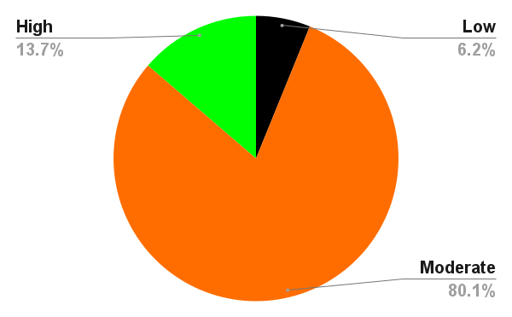
INTRODUCTION QUESTIONS METHODS RESULTS FUTURE

Slide 27
Q: Can we better utilize our “confidence” label?
A: Yes! How?
Potential changes: 1. Adding additional labels (low to moderate, moderate to high, etc)
2. Add confidence to forecast text and separating it based on Sea
3. User feedback
INTRODUCTION QUESTIONS METHODS RESULTS FUTURE
Notes:
Our main question we will answer today is how can we verify our ice edge forecast? Additional questions include, what impacts the forecast accuracy and can we better utilize our “confidence” label of high/moderate/or low? Note: Known limitations include relying on human interpretation of satellite data and estimating the true sea-ice conditions based on observations, or lack thereof. Low to Moderate, Moderate to Low

Slide 28

Thank you!

